Slide 1
My apprenticeship in Munich
My company:
KARE Muenchen - Outlet

Slide 2
KARE Design GmbH manufactures and retails furniture, lighting, furnishing accessories, and gift articles. The company was founded in 1981 and is based in Munich, Germany.

Slide 3
DATABASE
My company has his own informations base.
Every package, order, sell or buy should be saved and marked in the database

Slide 4
Order Fulfillment
1. The customer must complete his order and then he gets the order number
2. Then, if the customer buys on the spot, all you have to do is give the number to the employee
3.If the customer orders online, he should send the order number to the company
4. payment is required to start shipment
5. Securing the shipment, marking and saving information in the database
The package is ready for delivery

Slide 5
My Duties
I am responsible for the safe packaging of orders
Correct marking of shipments
The correct arrangement of shipments in the warehouse
And sometimes i have to clean floor :<

Slide 6
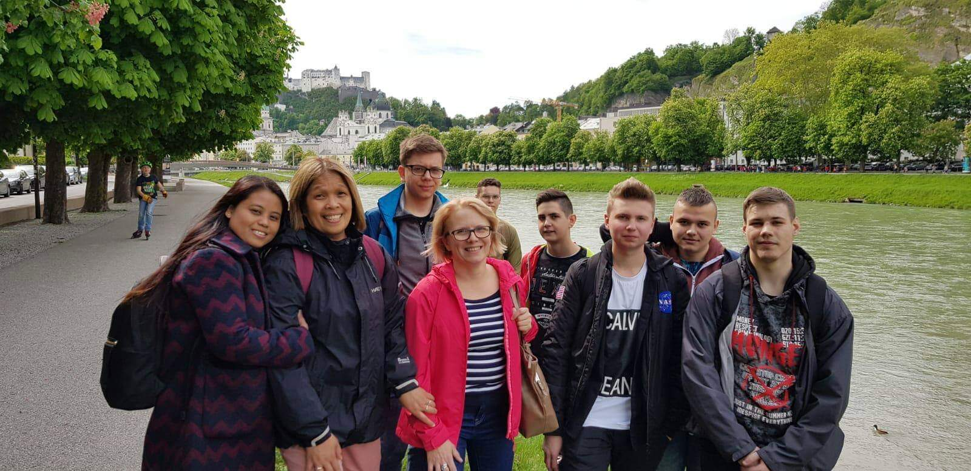
Free Time
Trip to Salzburg

Slide 9
Trip to Chiemsee Lake

Slide 11
Thank you for attention

